Slide 1


Slide 2
Who is PROMECH?
With more than 18 years of experience and expertise, PROMECH Group has succeeded in becoming a market leader in product Development and Machinery Solutions. PROMECH developed a reputation for providing diversified technology and engineering Solutions, and giving access to state of the art know how and cutting edge technological tools.
Our goal is to transform Egypt and the Middle East into a leading industrial powerhouse and a global logistics hub in promising growth sectors (with focus on Industry 4.0), which will enhance the trade balance, stimulate economic growth, create job opportunities, maximize local content and boost our exports.

Slide 3
History Of SOCO
Founded in 1979 in Taiwan by Soco.
Expansion 1986.
Tube benders production in 1988.
Construction of new factory in 2003.
Completion and delivery of Soco’s first tube laser in 2009.
Open new factory in Nantou in 2020.

Slide 4
Applications
Industries: Solutions:
Automotive Tube Laser
Furniture Sheet metal + Robot Laser
Heavy Industry Tube Benders
Aerospace Tube + Bar Cutting
Construction Tube End Finishing
Fitness Tube End forming
Healthcare
Playground

Slide 5
Laser Cutting:
2D Tube Laser
3D Tube Laser
Semi-Automatic (FA Laser)
Straight Cutting
Sheet Metal Laser Cutting
Robot Laser Cutting

Slide 6
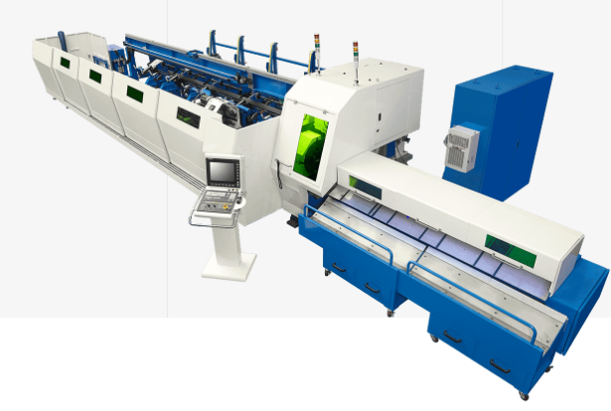
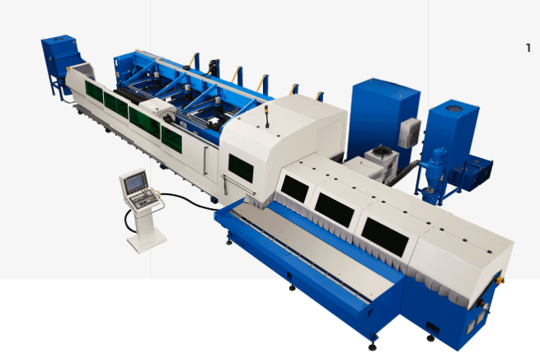
2D Tube Laser
SLT-102-FIBER
SLT-152-FIBER

Slide 7
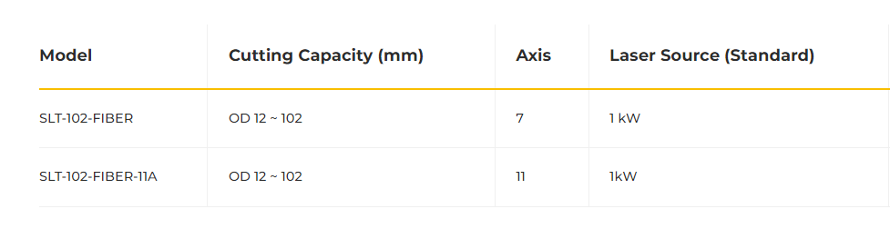
SLT-102-FIBER The machine can join multiple processes in one system, saving production time and reducing labor costs.

Slide 8
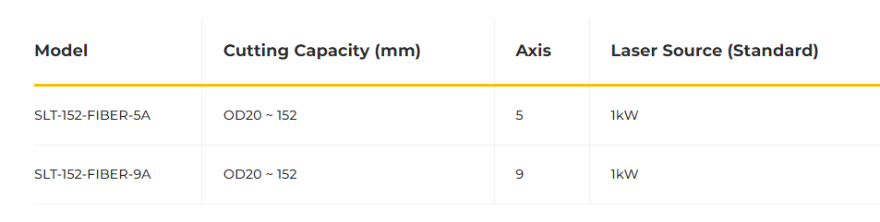
SLT-152-FIBER With SOCO SLT-152-FIBER, multiple jobs such as straight and angle cutting, slotting, marking, notching, and hole making are possible in one single process

Slide 9
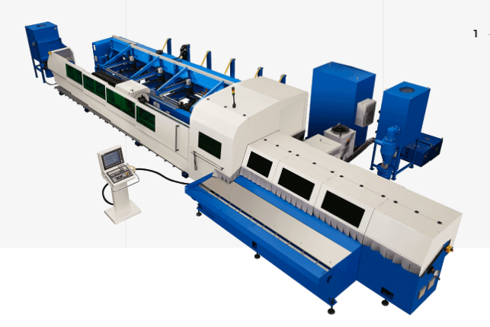
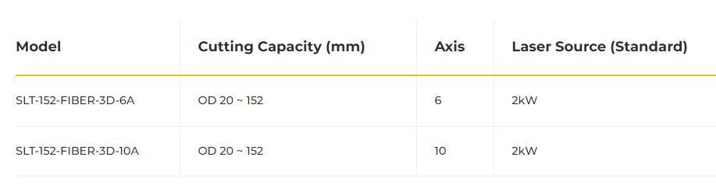
3D Tube Laser
SLT-152-FIBER-3D

Slide 10
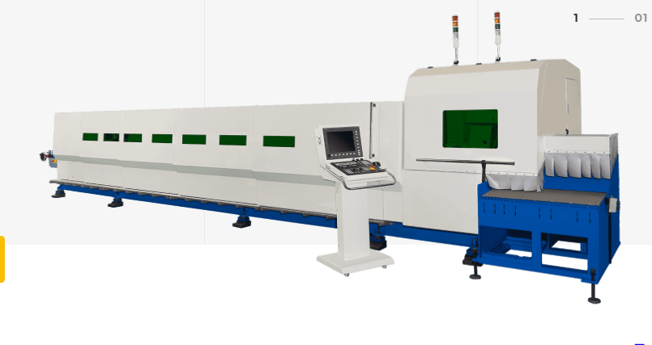
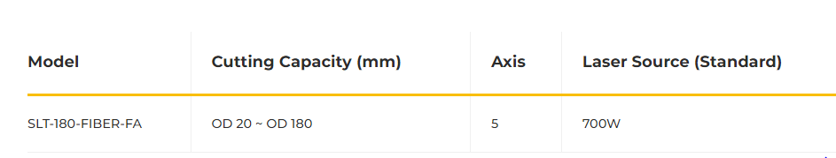
Semi-Automatic (FP Laser)
SLT-180-FIBER-FA

Slide 11
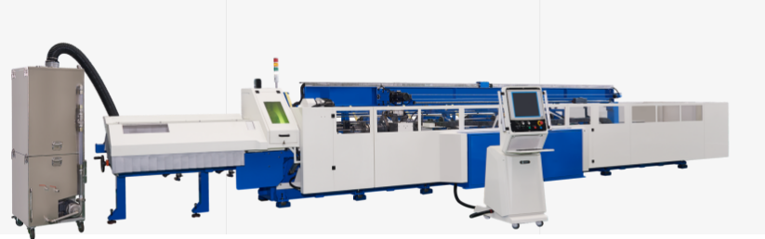
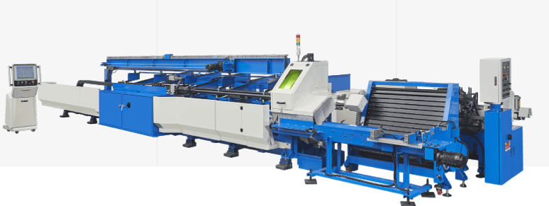
Straight Cutting
SLT-Round cut-100
SLT-Round Cut-SS

Slide 12
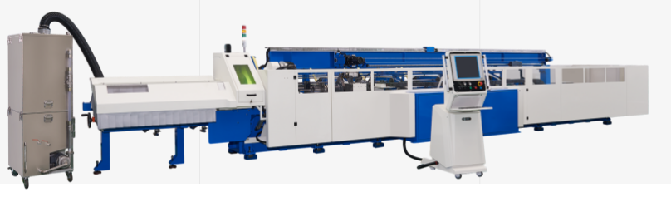
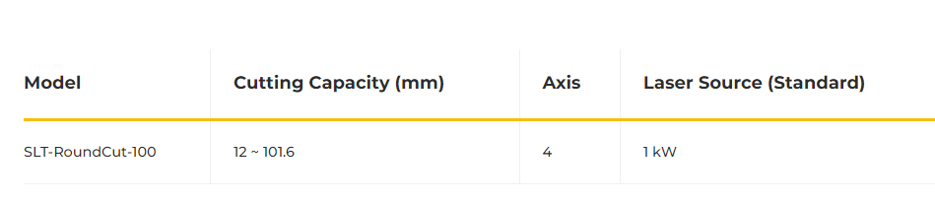
SLT-Round cut-100
Tube Laser straight cutting , Lengths from 2mm to 2m.

Slide 13
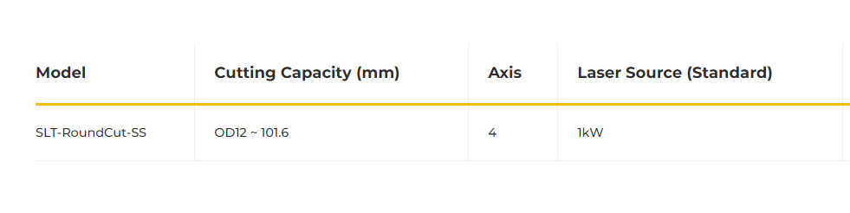
SLT-Round Cut-SS Tube Laser straight cutting, short lengths.
Advantages of SLT-Round Cut-SS Tube Laser line:
No Saw Blade, Fiber Laser Technology
Cuts any Material Hardness or Tensile Strength Material
Lowest Cost per Cut
Minimal Setup Time + High Output
Minimal Tube Deformation and Surface Marks
Low Maintenance

Slide 14
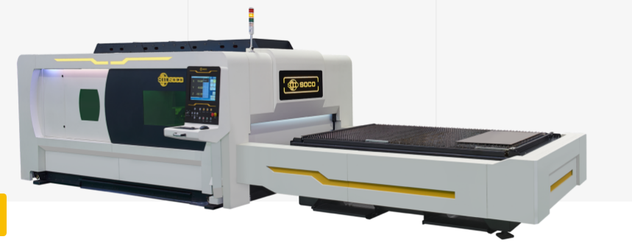
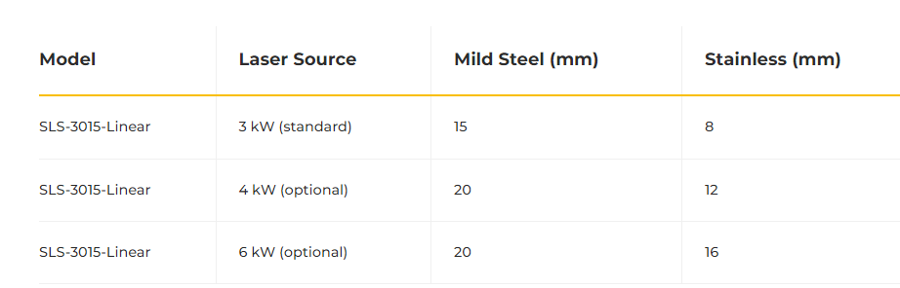
Sheet Metal Laser cutting
SLS-3015 (All linear Sheet Metal Laser Cutting)

Slide 15
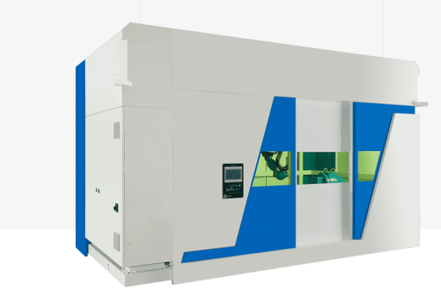
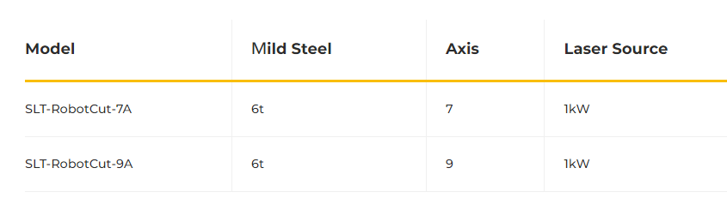
Robot Laser Cutting
SLT-Robot Cut
(Robot 3D Laser Cutting)

Slide 16
Tube Benders
CNC Tube Benders
Special Purpose Benders
NC Benders
End Forming
I2 software
Advanced Technology

Slide 17
CNC Benders
All Electric + Left and Right (U Series)
LD Booster (SR+PT Series)
Rolling + 1D Bending (V Series)
Hybrid Electric (A Series)
Heavy Duty (6BSeries)
+1 Hydraulic (Auto + 2B Series)

Slide 18
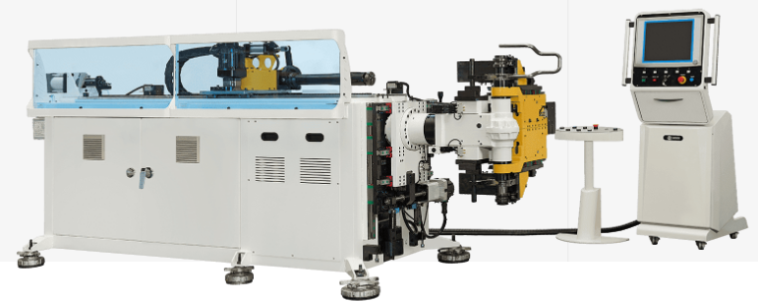
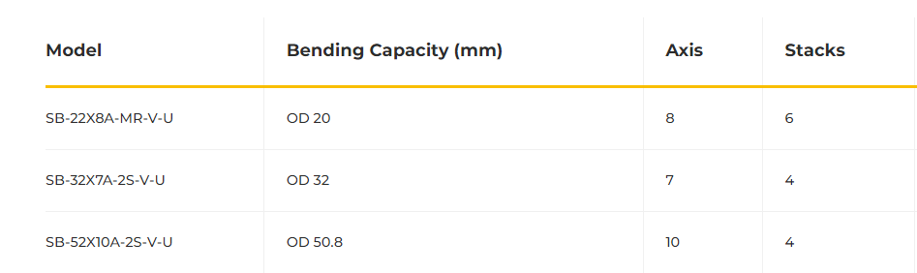
All Electric + Left & Right (U series)

Slide 19
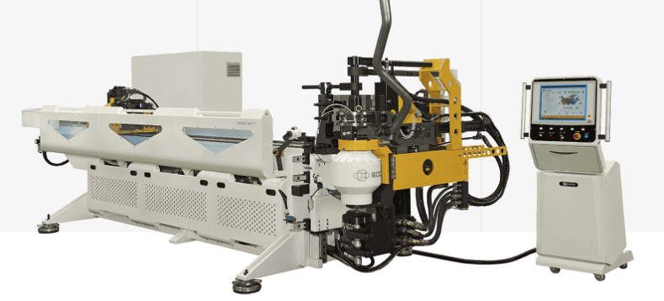
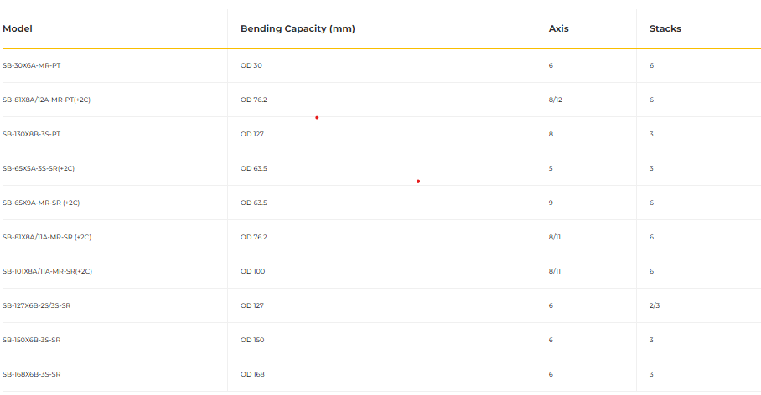
LD Booster (SR+PT Series)

Slide 20
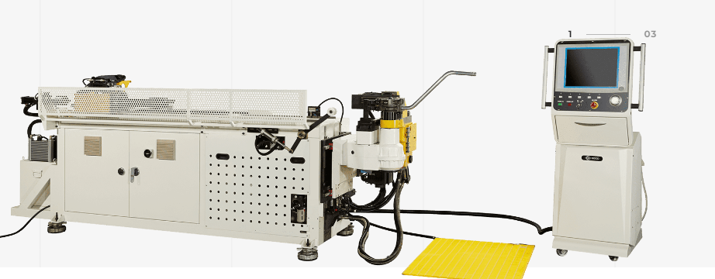
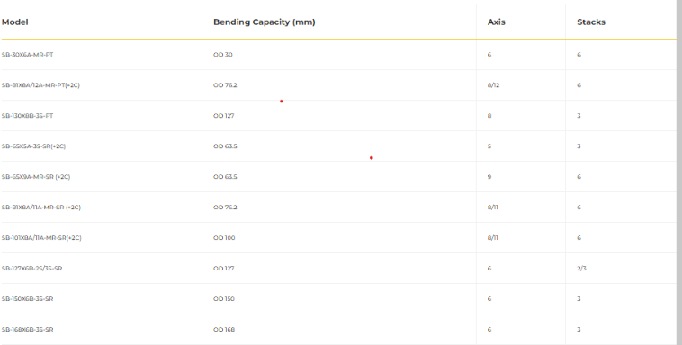
Hybrid Electric (A Series)

Slide 21
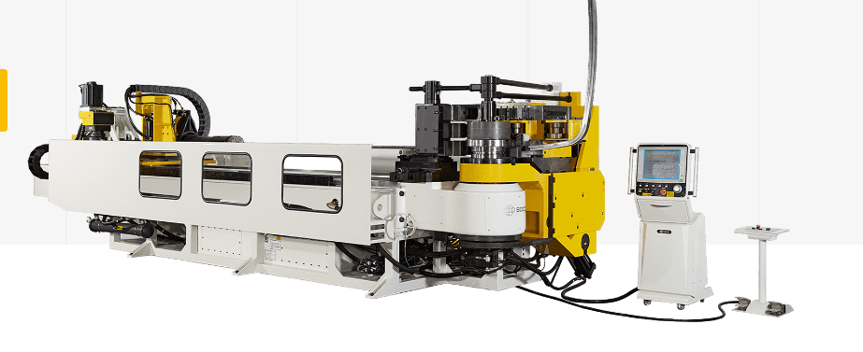
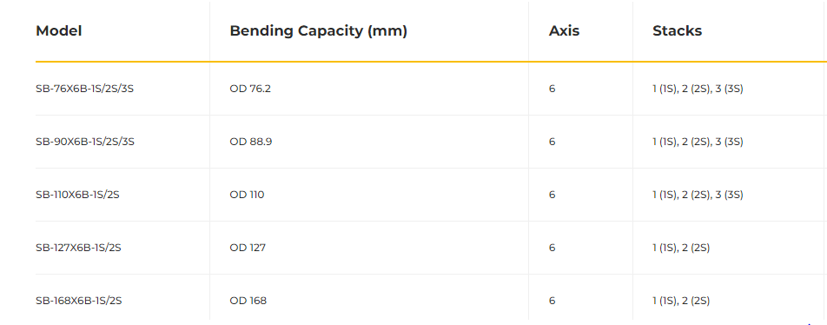
Heavy Duty (6B Series)

Slide 22
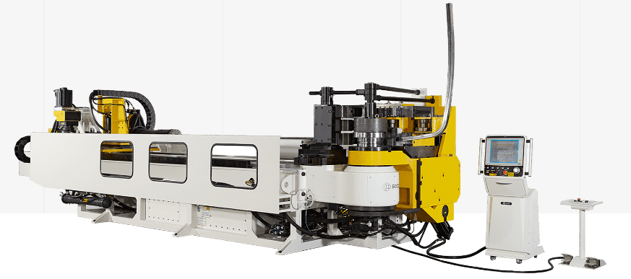
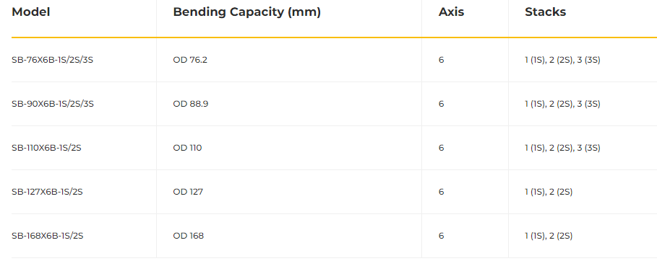
Heavy Duty (6B Series)
6 individually programmable axes
Max. OD 168 mm capacity
Programmable 2 speeds early mandrel extraction
Each axis may be individually programmed during arm return mode

Slide 23
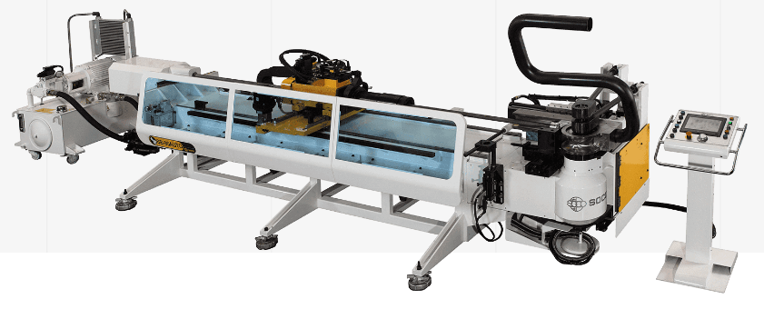
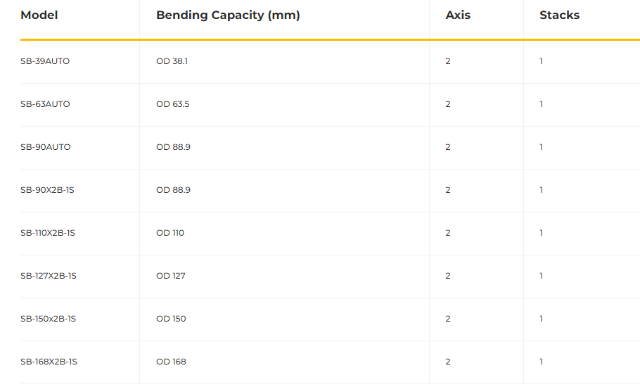
2+1 Hydraulic (Auto + 2B Series)
CNC pipe bending machines with a capacity up to OD 168 mm.
Fully Automatic and Cost-Effective.
This Pipe Bending line is equipped with 3 programmable axes:
- Feeding – Electric Servo; - Rotation – Electric Servo; - Tube Bending – Hydraulic (NC).

Slide 24
Special Purpose Benders
Brake Line (Soco Tube Benders for vehicle Brake Lines)
Trunk Hinge (Soco Tube Benders Designed for trunk Hinge production)
Car Headrests (Soco left & Right Tube Benders designed for Car headrests)
Coil (Bending, Cutting, forming)
Serpentine (Soco Tube Benders for serpentine Shapes)

Slide 25
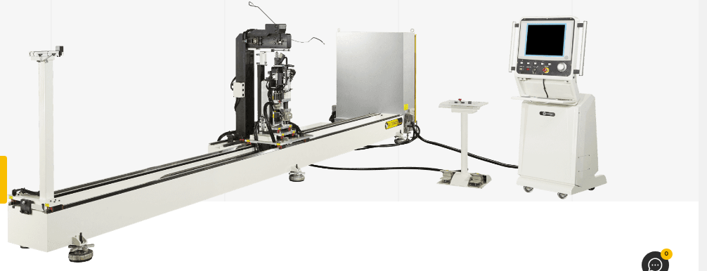
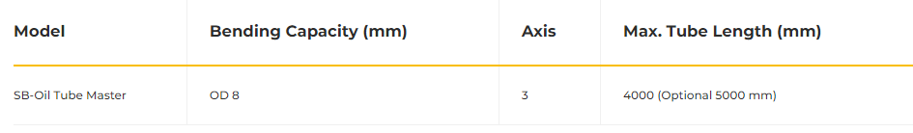
Brake Line (Soco Tube Benders for vehicle Brake Lines)
Electric Axis Tube Benders for Vehicle Brake Line Tube Length capacity up to 5000 mm

Slide 26
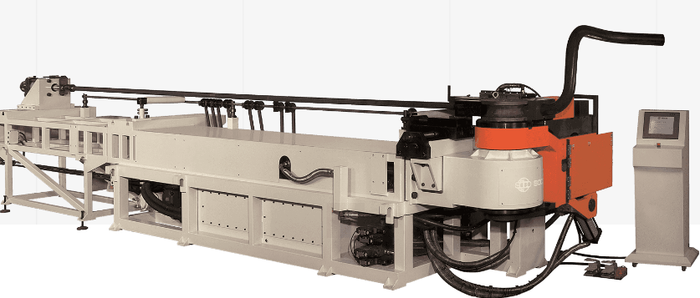
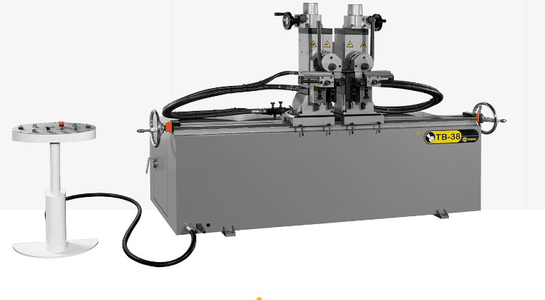
NC tube Benders
1 Axis Hydraulic Bender
Double Heads tube Bender

Slide 27
End Forming
E types
IO types
IOE types
Multi-Stations Tube End Former

Slide 28
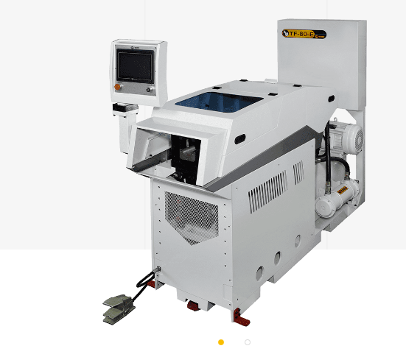
E types
Draw + Roll 1+ 1D Bending
High Speed and Environmentally friendly
9-Axis

Slide 29
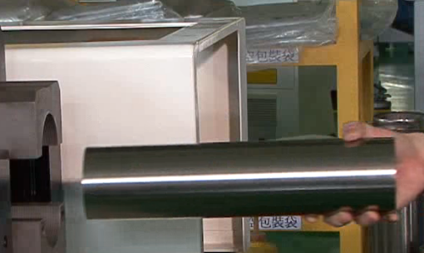
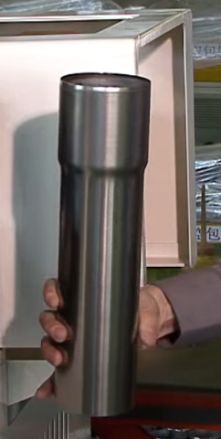
IO types
OD 82 mm.
Ram Forming

Slide 30
Advanced Technology
DGT (Direct Gear Transmission)
2C (Double Blades Shearing)

Slide 31
Tube Cutting
Tube Cutting Lines
Bar + Tube Cutting
Automatic Feeding + Cutting
Semi Automatic + Manual

Slide 32
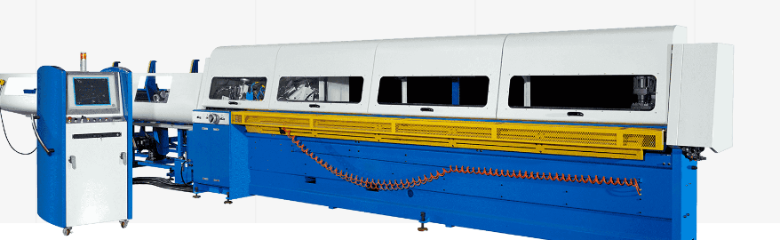
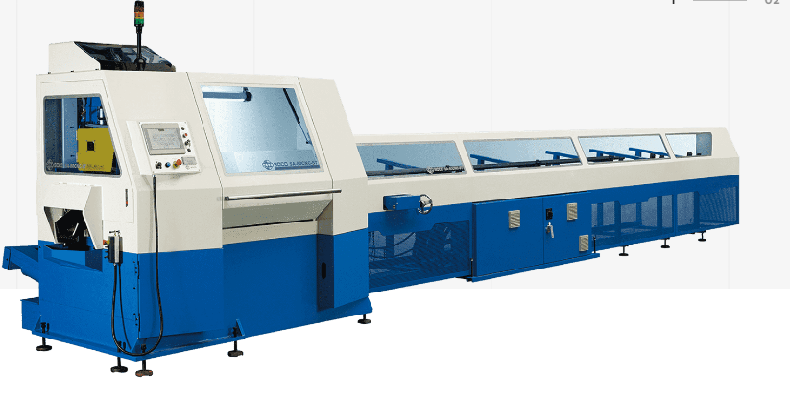
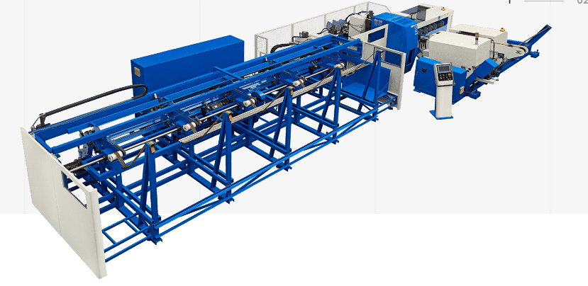
Tube Cutting Lines
SA-78NCE (Tube Cutting for High Tensile Strength Steel)
SA-80CNC-ST (2 Tubes Cutting Line)
SA-85NCE (4 Tubes Cutting Line)

Slide 33
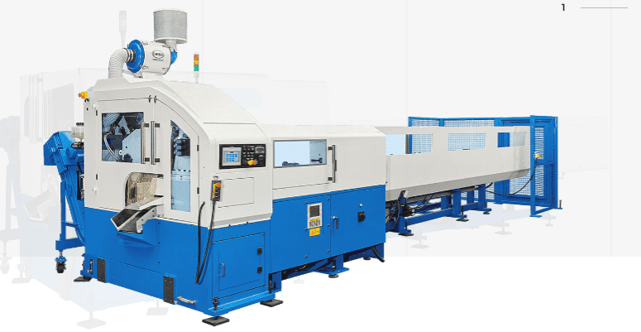
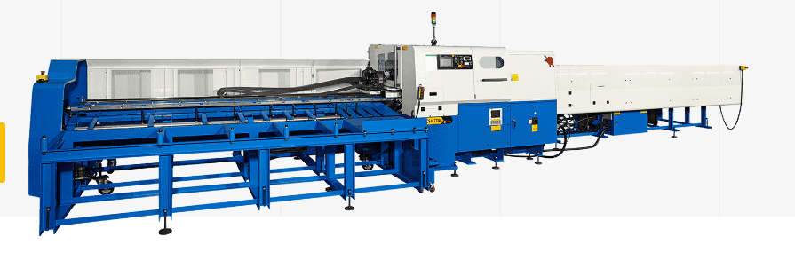
Bar + Tube Cutting
Short cut Lengths (500 mm Cutting Length)
Long Cut Lengths (3000 mm cutting length )

Slide 34
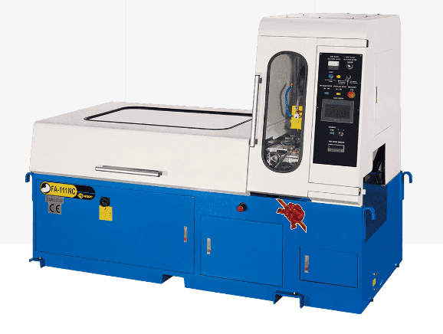
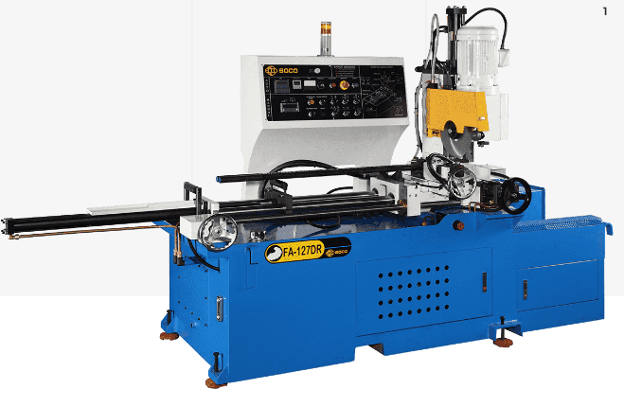
Automatic Feeding + Cutting
NC Servo Feeding (NC Type)
Hydraulic Feeding (DR Type)

Slide 35
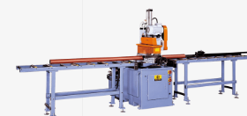
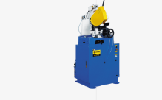
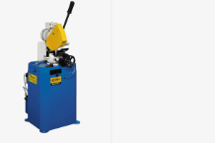
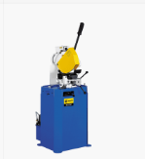
Semi Automatic + Manual
Hydraulic (HVS-AC Type)
Pneumatic Clamping + Cutting (AC Type)
Pneumatic Clamping (PV Type)
Manual (F Type)

Slide 36
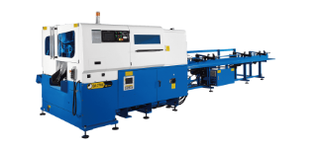
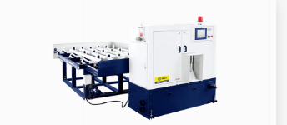
Non-Ferrous Cutting
Copper + Brass Tube Cutting
Aluminum + Copper Tube Cutting

Slide 37
Differences between Laser and tube cutting
On the automatic pipe cutting production line, the focused laser beam must be synchronized with the pipe cutting;
It is required that the focused laser focus can rotate for one cycle relative to the pipe being cut, and the axis of the laser beam always intersects the axis of the pipe.
During the cutting process, the laser beam of the tube cutting production line moves with the tube to be cut. These synchronous movements must be controlled by a special control system, so the research on the automatic production line of laser tube cutting is also of great significance.
The tube laser cutting machine adopts a non-contact processing method. During the entire processing process, the tube wall will not be subjected to pressure and will not cause deformation or collapse of the tube surface.
Compared with traditional processing equipment such as flame cutting, plasma cutting, and water cutting, the precision of laser cutting metal plates is much higher.

Slide 38


